Slide 1
Sexual Harassment Classification Using ML
By
Chennuri Pavan Kumar-42130096-A2 Chilakala Ajay Maheswara Reddy-42130099-A2 Kompella Sri Rama Anudeep-42130229-A4 Vaddi Ugandhar-42130516-B3

Slide 2
Introduction
Project Aim: Detect and classify text related to sexual harassment on social media platforms.​
Classification Stages: Identify various stages of harassment, including commenting, staring, and touching.​
Machine Learning Algorithms: Utilize supervised learning techniques such as K-Nearest Neighbors (KNN), XGBoost, Random Forest, and Ensemble learning methods to train models for accurate classification.​
Significance: Implementing these machine learning techniques aids in the early detection and prevention of harmful online behavior, contributing to a safer digital environment.

Slide 3
Objective
Develop an automated system to detect and classify harassment-related text.
Utilize ML algorithms like KNN, XGBoost, and Random Forest for classification.
Improve classification accuracy with ensemble learning techniques.
Identify different levels of harassment effectively.
Enhance online safety by detecting and addressing harmful content.

Slide 4
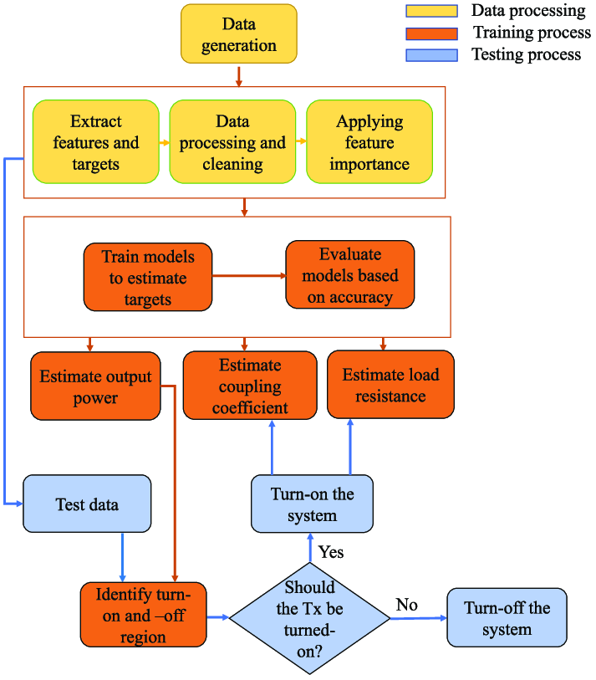

Slide 5
Problem Definition
Problem Statements:
Increasing cases of online harassment.
Lack of automated detection systems.
Manual moderation is time-consuming and inefficient.
Psychological impact on victims due to unchecked harassment.
Difficulty in identifying subtle or context-dependent harassment.
Solution Addressing:
Develop an automated ML-based detection system.
Implement advanced classification techniques using deep learning.
Reduce dependence on manual moderation with real-time detection.
Provide tools to empower users in reporting and recognizing harassment.
Enhance online safety by filtering harmful content efficiently.

Slide 6
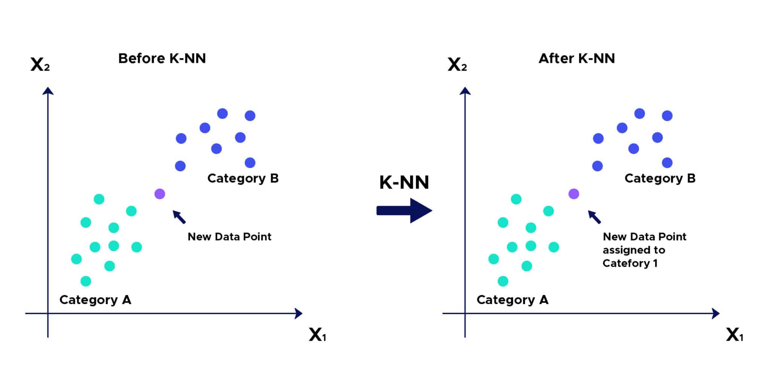
KNN(K-Nearest Neighbors)

Slide 7
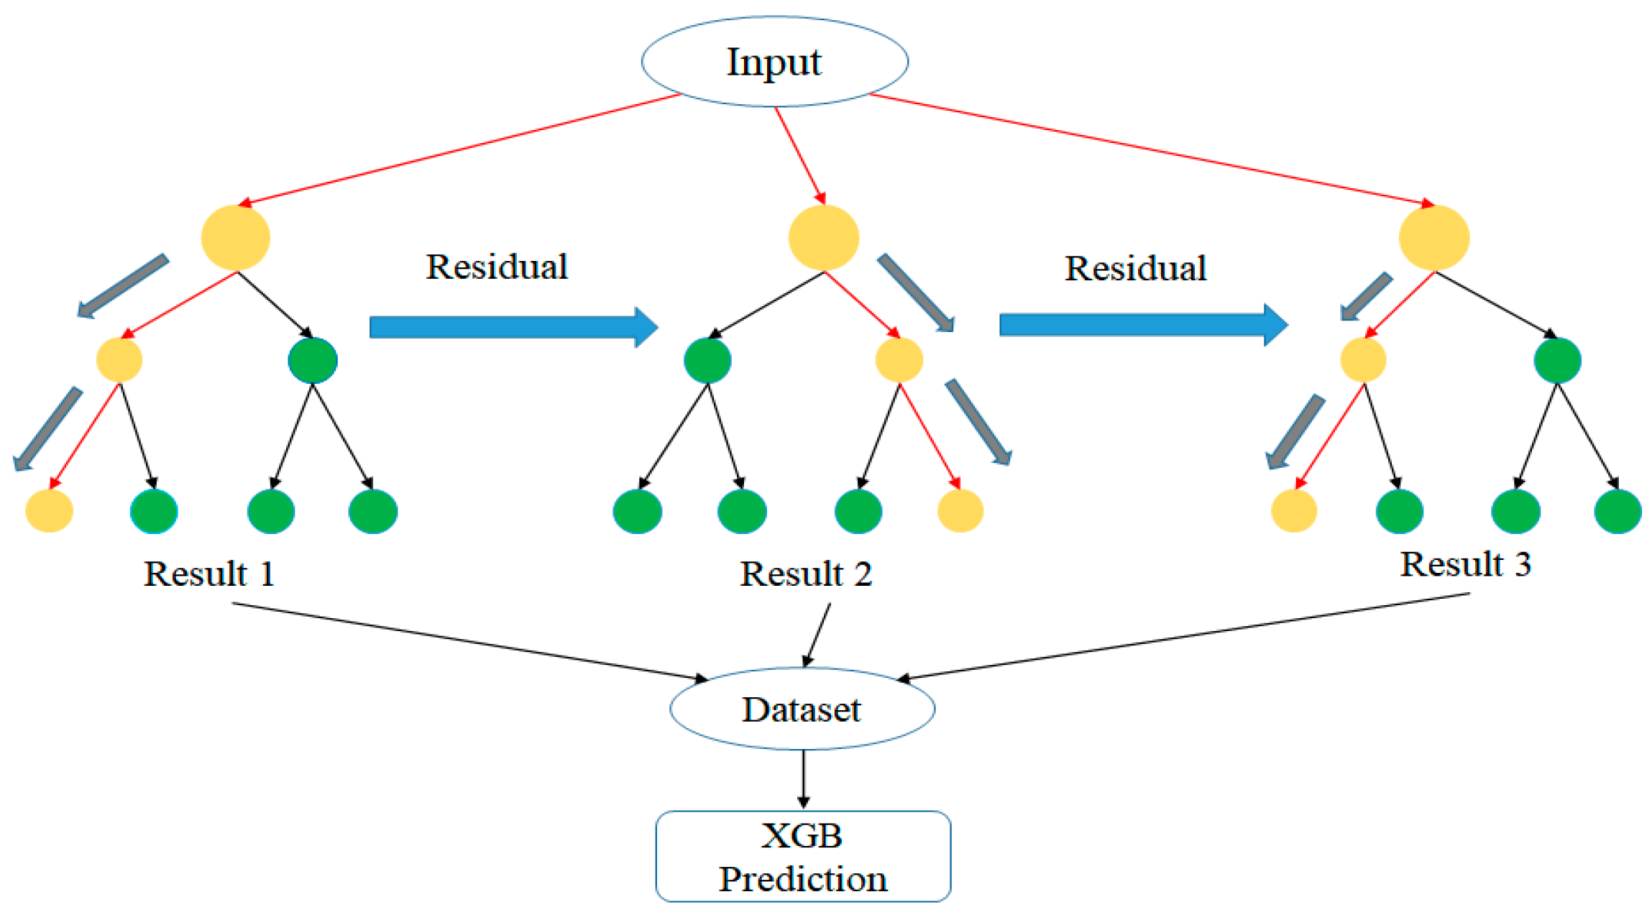
XGBoost (Extreme Gradient Boosting)

Slide 8
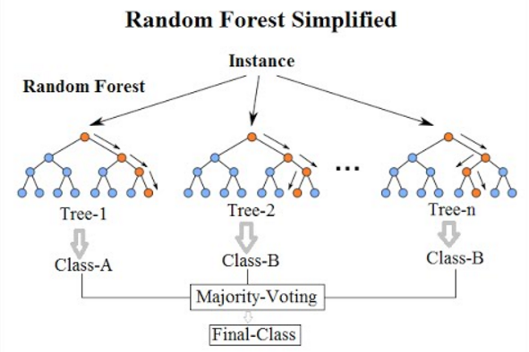
Random Forest Algorithm

Slide 9
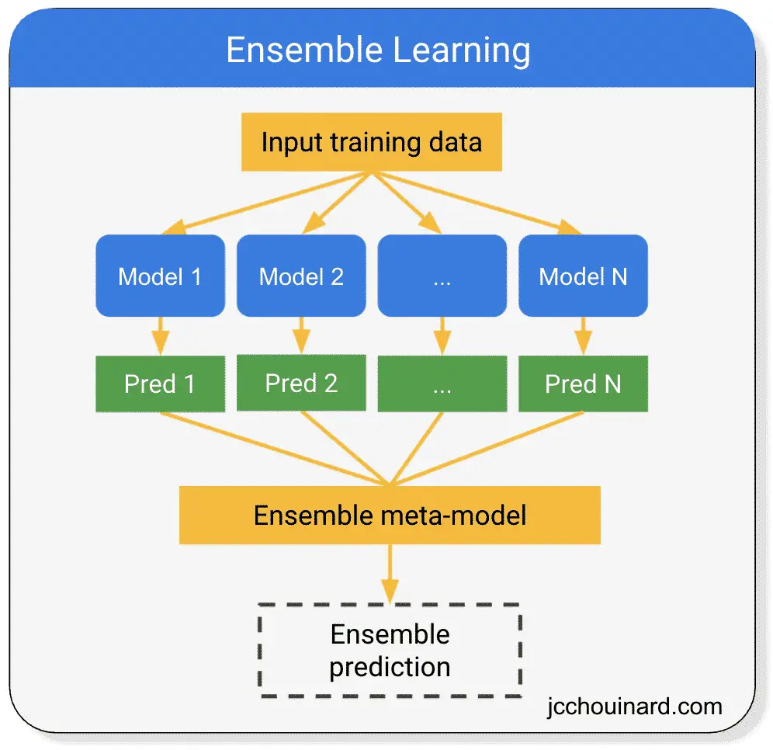
Ensemble Learning - Overview

Slide 10
Literature Survey
Algorithm | Description | Usage in Harassment Detection | Research
KNN | Classifies data based on nearest neighbors | Effective for small datasets but computationally intensive | Enhancing Customer Retention with Machine Learning. (ScienceDirect).
XGBoost | Optimizes weak classifiers for better accuracy. | Handles complex text relationships; effective in offensive language detection | A Robust Ensemble Learning Model for Cyber Harassment Detection. (Springer)
Random Forest | Uses multiple decision trees for stable predictions. | Detects patterns in large-scale text; handles offensive content variability. | XGBoost and Random Forest Algorithms: An In-Depth Analysis. (ScienceDirect).
Ensemble Learning | Merges multiple models to improve accuracy. | Enhances detection accuracy and reduces false positives/negatives. | Classification of Virtual Harassment on Social Networks Using Ensemble Learning. (Springer).

Slide 11
Existing Methodology
Manual Moderation – Human moderators review and flag inappropriate content, but this is slow and inconsistent.
Keyword-Based Filtering – Uses predefined word lists to detect harmful text, but lacks context awareness.
Rule-Based Systems – Detects patterns based on fixed rules, but cannot adapt to evolving language.
Sentiment Analysis – Determines emotional tone but struggles with nuanced or indirect harassment.
AI-Based Moderation (Basic Models) – Some platforms use AI, but models have limited accuracy and may misclassify content.

Slide 12
Proposed Methodology
[In progress]

Slide 13
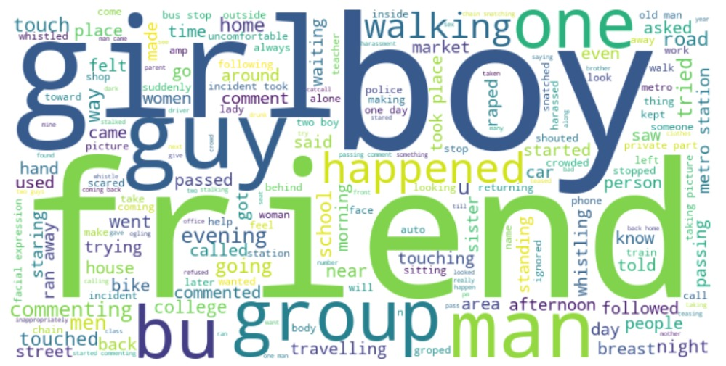

Slide 14
References
Title | Year | Problem Definition
A Deep-Learning Approach to Early Identification of Suggested Sexual Harassment from Videos | 2023 | Develops a deep-learning model to identify sexual harassment, abuse, and violence in video content, focusing on visual attributes such as facial expressions and unwanted touching
Detection of Harassment Toward Women in Twitter During Pandemic Based on Sentiment Analysis | 2023 | Utilizes sentiment analysis to detect harassment toward women on Twitter during the pandemic, highlighting the increase in online harassment cases.
Sexual Harassment Detection using Machine Learning and Deep Learning Techniques for Bangla Text | 2023 | Focuses on detecting sexual harassment in Bangla text using machine learning and deep learning techniques, aiming to improve safety in digital communications.

Slide 15
Title | Year | Problem Definition
Towards Automated Sexual Violence Report Tracking | 2019 | Proposes a supervised learning model to automate the tracking of sexual violence reports, aiming for scalability and reliability compared to traditional methods.
Machine Learning Approaches to Detect Online Harassment Using Bag of Words | 2021 | Investigates early detection of online harassment through machine learning models utilizing bag-of-words representation to identify harmful content effectively.

